Slide 1
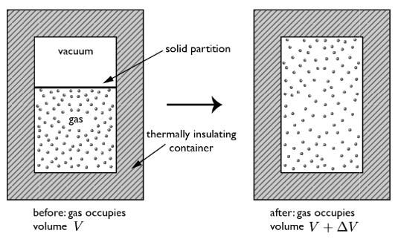
Thermodynamic Work done in Free Expansion is ZERO.
(Are we violating the definition of mechanical work)
It is an Irreversible process
(can be understood only in terms of ENTROPY generation)

Slide 2
HEAT or WORK both are energy in TRANSIT.
Once they cross the system boundary, they disappear
&
become the part of ENERGY of the system.

Slide 3
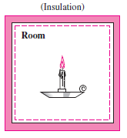
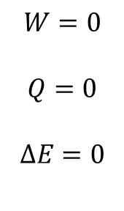
Burning of a Candle in an Insulated Room
System Boundary

Slide 4
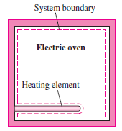
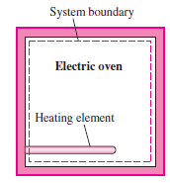
Heating of an Oven by Work Transfer
Heating of an Oven by Heat Transfer

Slide 5
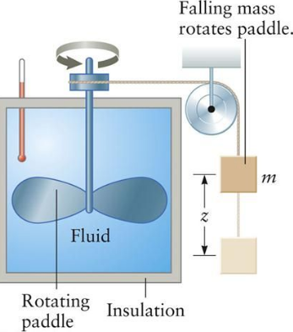
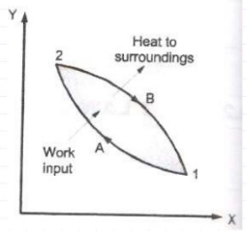
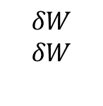


Joule’s Experiment (1848)
There exists for every thermodynamic system a property called the energy. The change of energy of a system is proportional to the mechanical work done on the system in an adiabatic process.

Slide 6
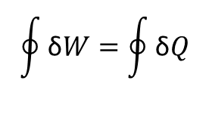
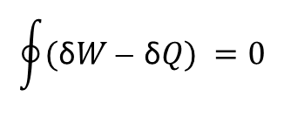


General version of Joule’s statement:
There exists for every thermodynamic system a property called the energy (E). The change of energy of a system is proportional to the mechanical work done on the system in an adiabatic process.

Slide 7
Thermodynamic Work = Generalized force (intensive variable) × displacement
(extensive variable)
Mechanical Work = pressure × volume
Stretching Work = surface tension × length
Electrical Work = Voltage × charge

Slide 8
Thermodynamic Properties
The distinguishing characteristics of a system, basically quantities needed
to specify a Macroscopic Description/State of System completely.
Either directly or indirectly measurable
Change is independent, hence can be written as exact differential.

Slide 9
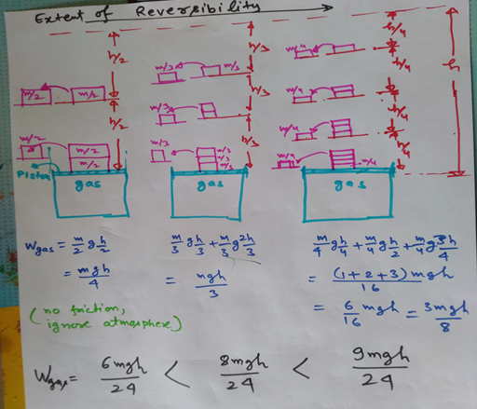
Internally Reversible Process (quasi static process)

Slide 10
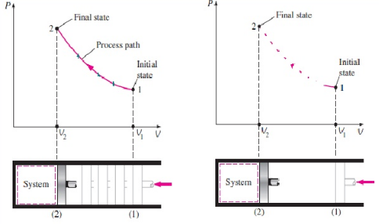
Quasi-static process
At every instant System departs only infinitesimally from Equilibrium state.
Quasi-static process
Non Quasi-static process

Slide 11
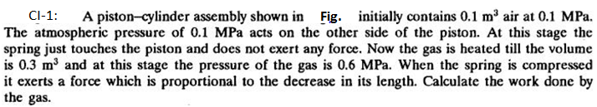
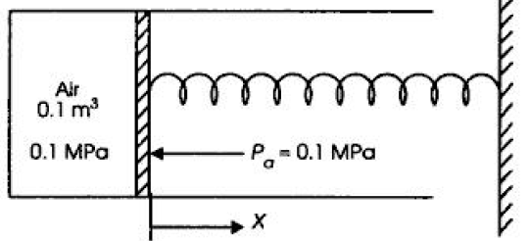



(CET, YVC Rao)
Ans: 70kJ

Slide 12
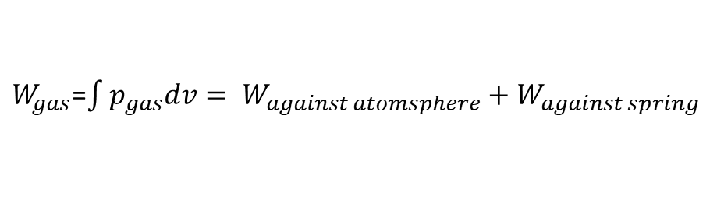

Mechanical equilibrium at each point, net force on piston is zero at any instant.

Slide 13
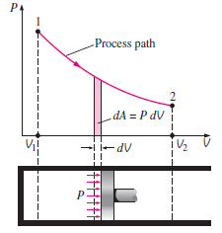

Slide 14
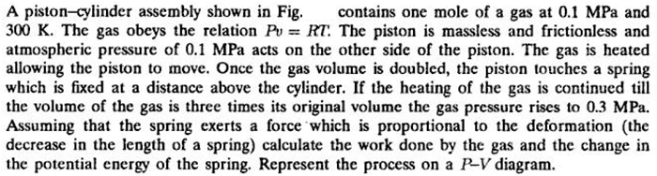
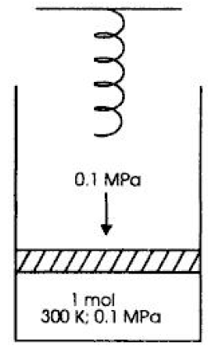
CI 2:
(CET, YVC Rao)
Ex. 2.13
7.4826kJ
2.4942 kJ

Slide 15
A reversible process :
- reversible both internally and externally, When reversed, retraces its forward path, and restores the initial state of system and surroundings - Is frictionless - Is never more than differentially removed from equilibrium - Traverses a succession of equilibrium states - Is driven by forces whose imbalance is differential in magnitude - Can be reversed at any point by a differential change in external conditions

Slide 16
